Slide 1
FIT PRO – DIET PLAN WEB APPLICATION
How to get started with 3D in PowerPoint
About this deck
Office subscribers can add 3D models to documents and rotate the angle to show the right view. If you don’t have a subscription, the deck simply shows a single view.

Slide 2
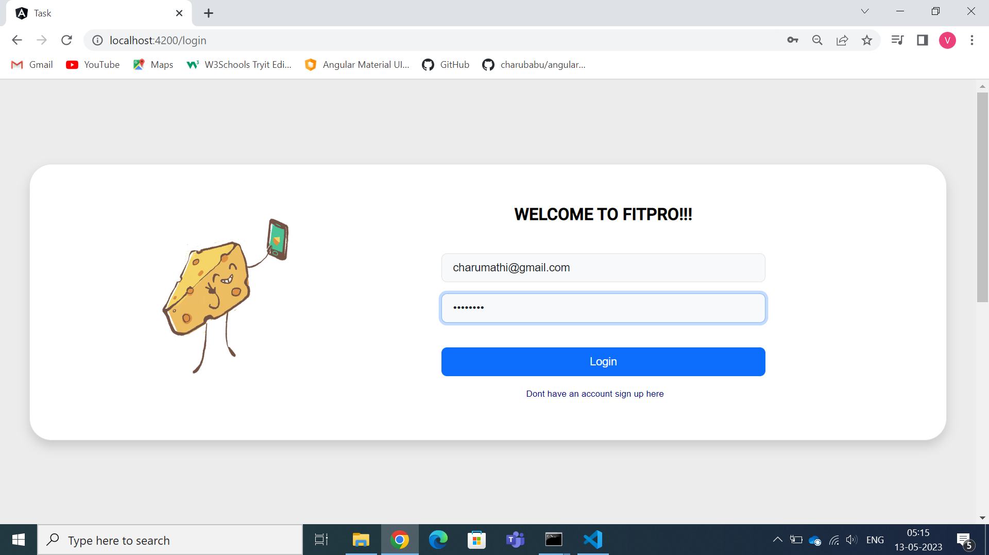
LOGIN PAGE
FitPro Inc Provides an Online Solution about Dietary plans, Nutritional Values, Fitness Suggestions and Solutions. They want their solution to be A web based solution as well as accessible on Mobile Apps. This Particular Solution We focus only on Web Based Solution A Single page App need to be built with multiple Flows.

Slide 3
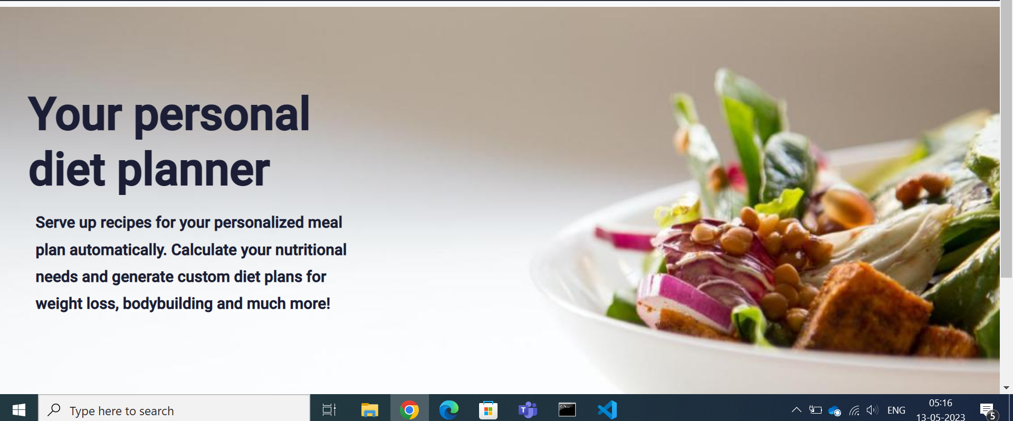
HOME PAGE

Slide 4
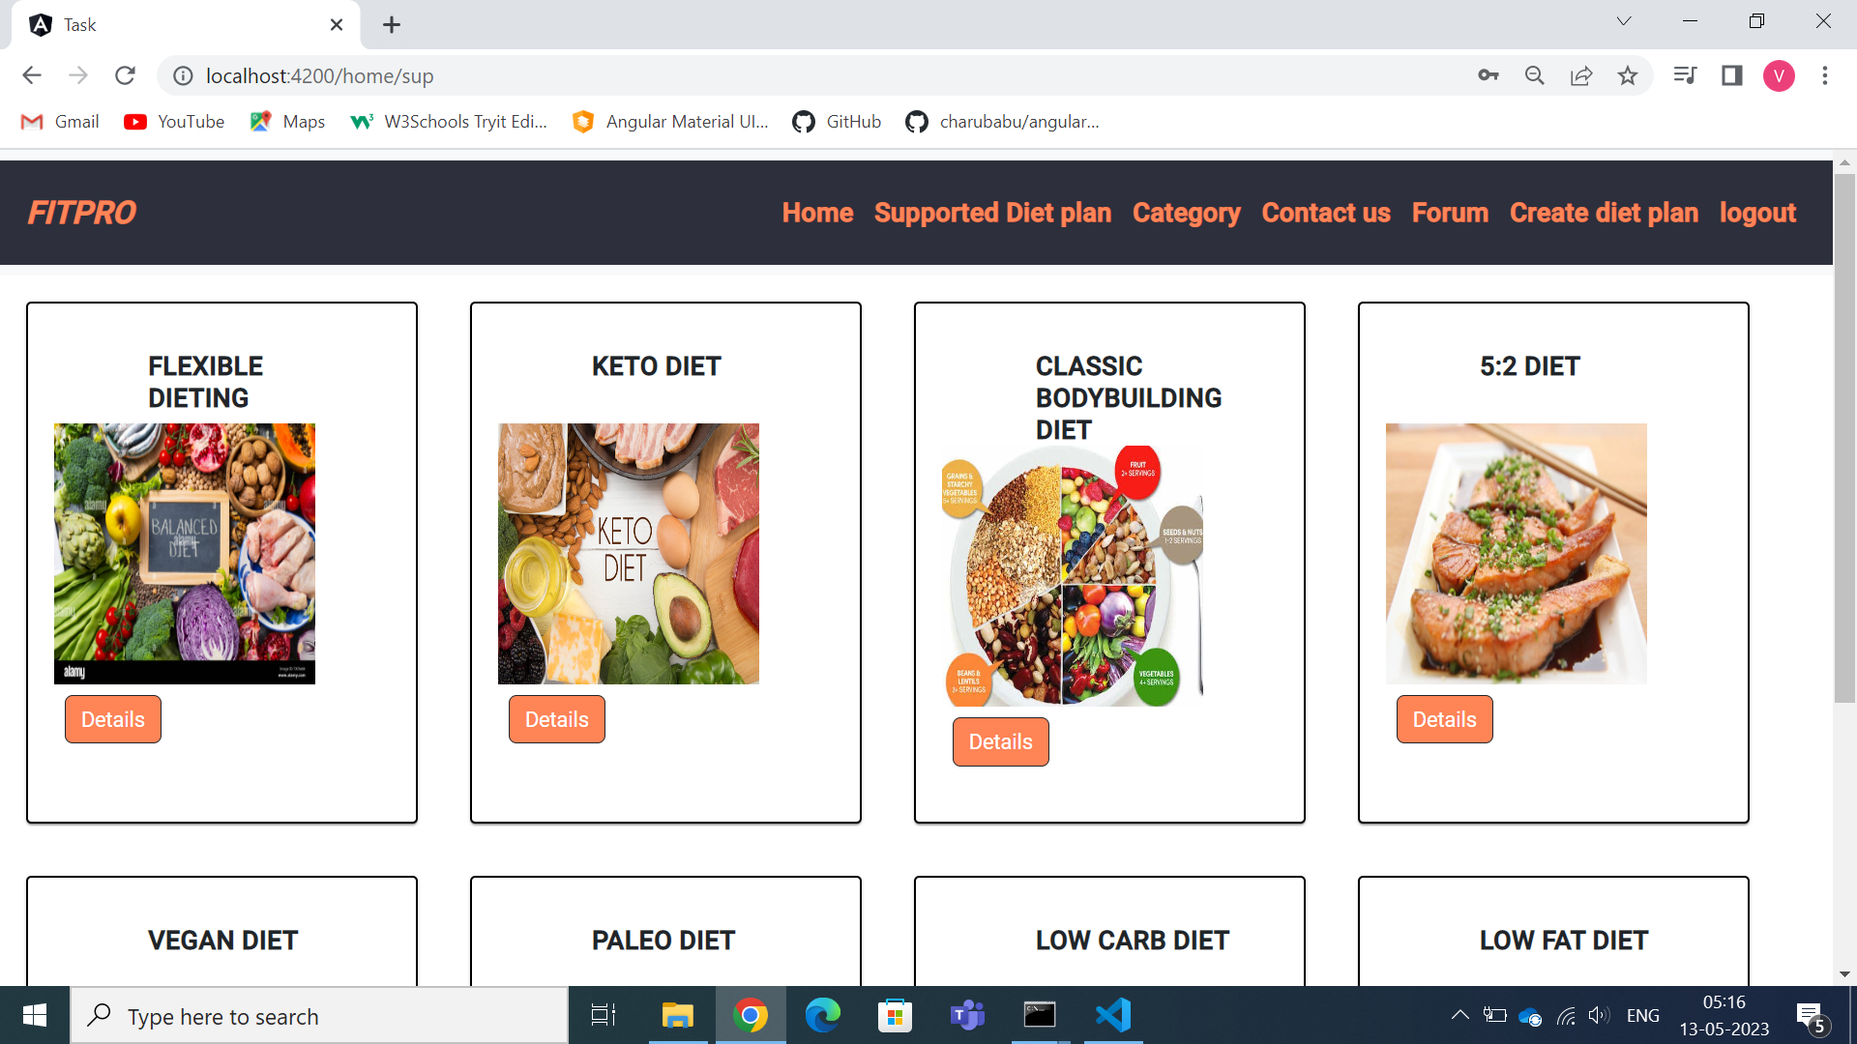
DIET PLAN DISPLAY PAGE
It displays different types of diet plans and the benefits of those diets.

Slide 5
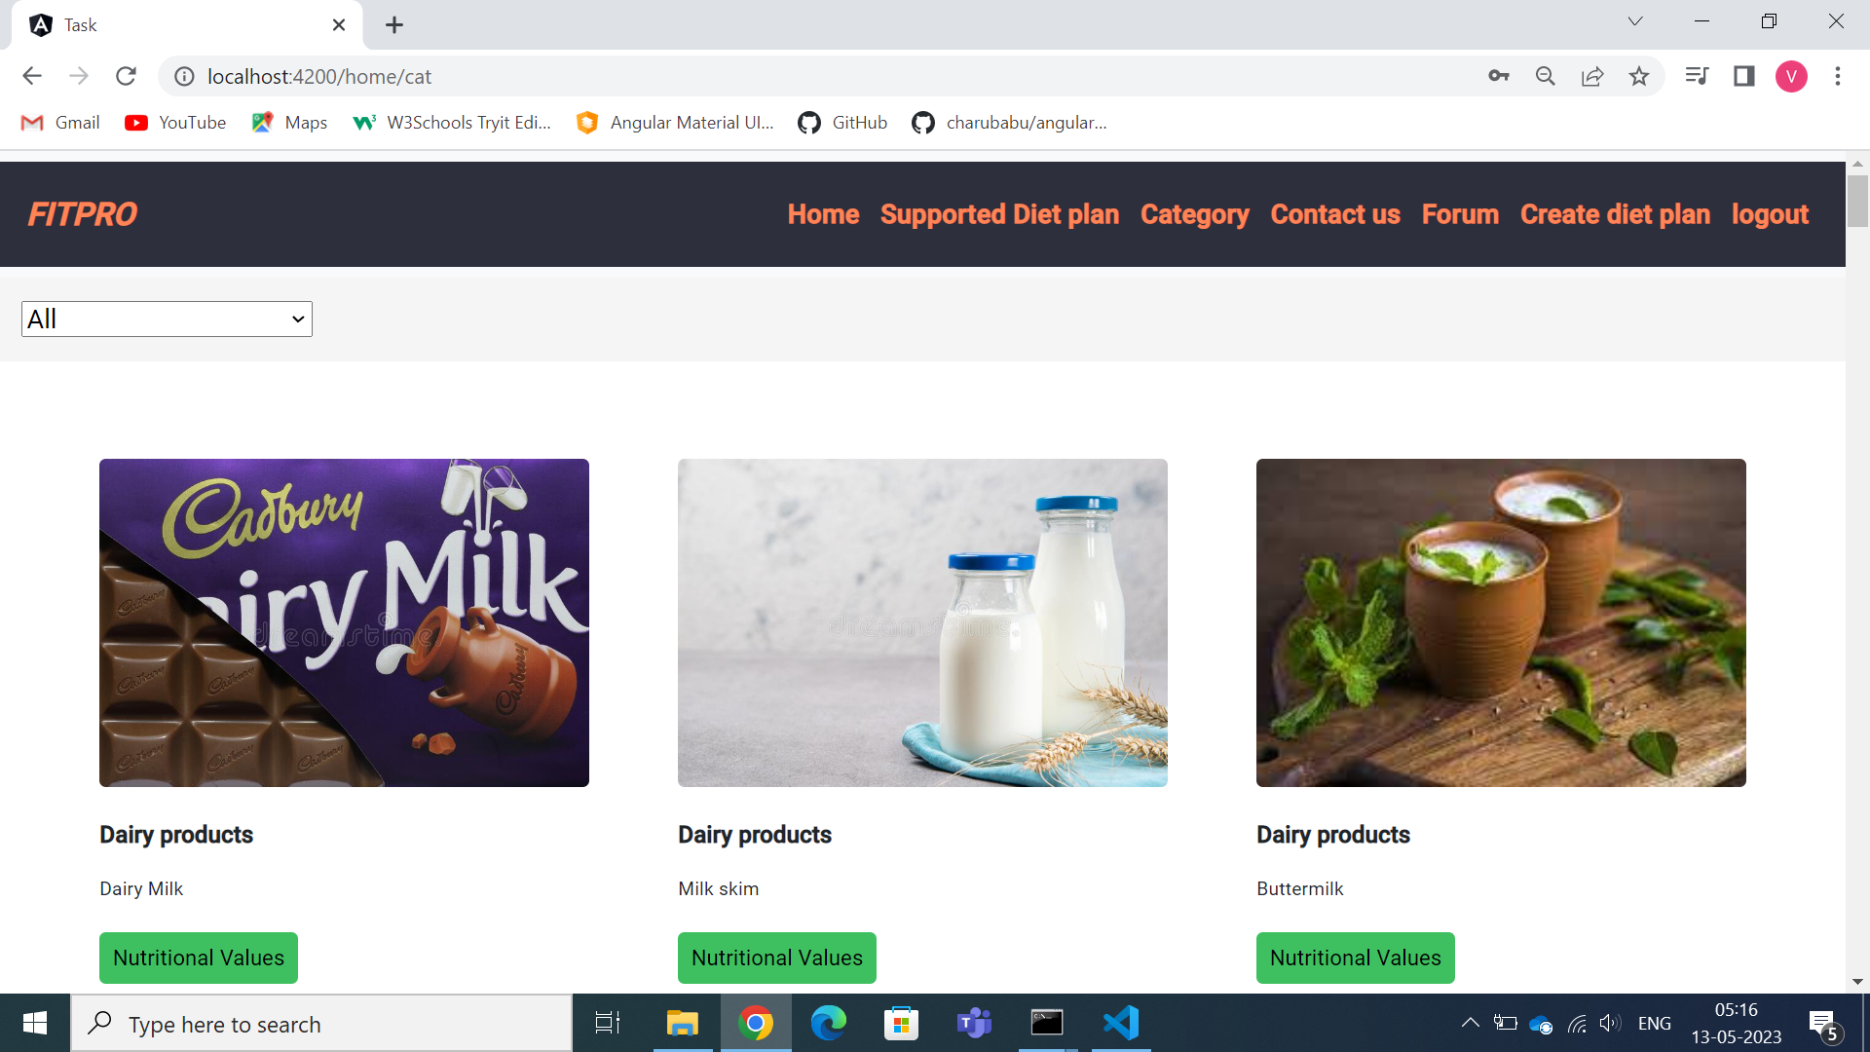
CATEGORY OF PRODUCTS
It displays different categories of products and it also shows nutritional values of those products.

Slide 6
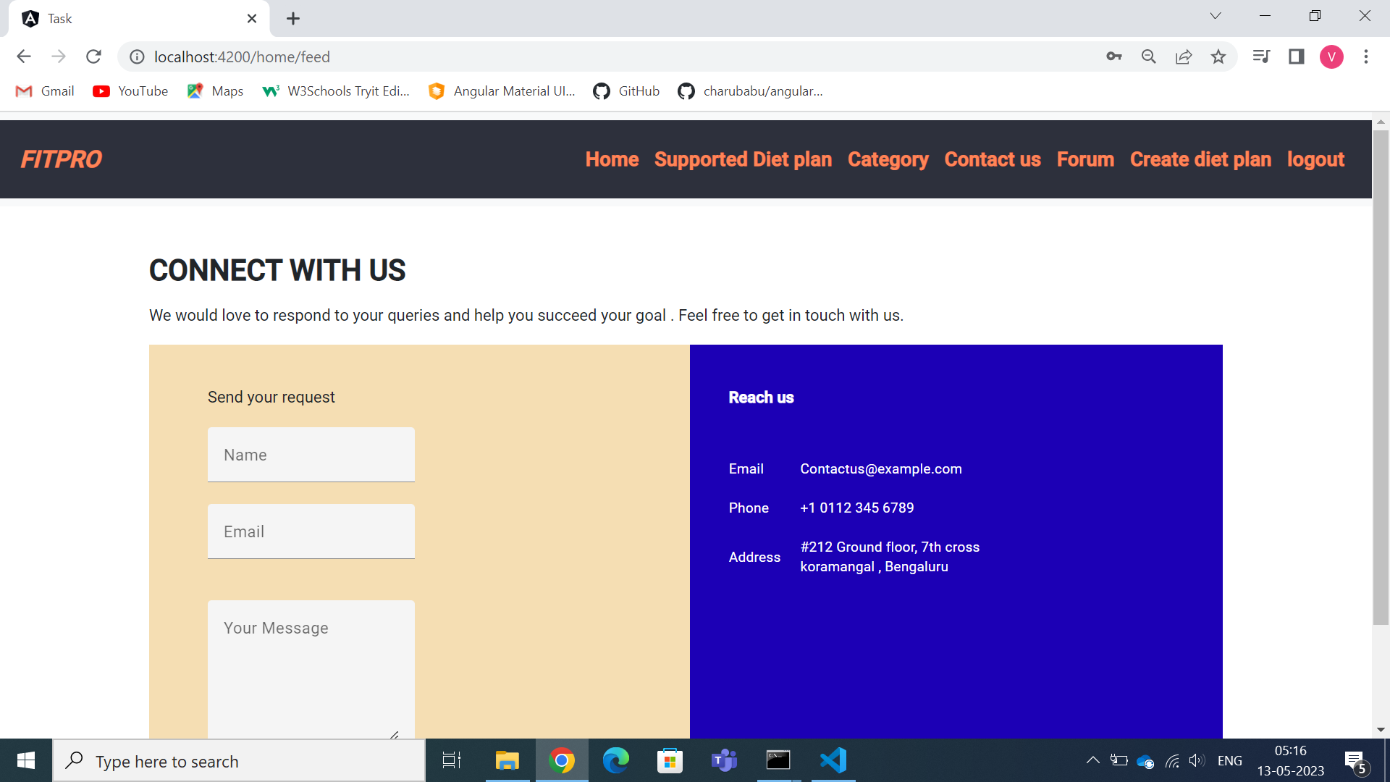
COMPLAINTS PAGE
The users can raise complaints regarding the products and nutritional benefits.
The complaints will be displayed in admin view page

Slide 7
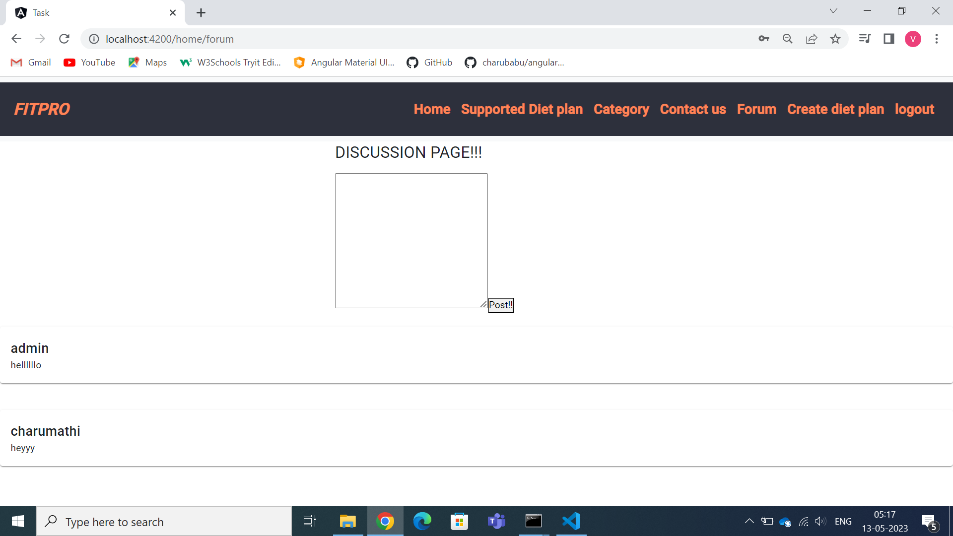
FORUM
Multiple users can have discussion regarding the products and admin can reply to it .

Slide 8
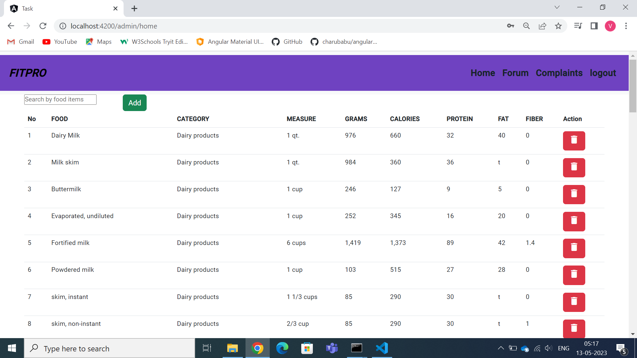
ADMIN – ADD/ DELETE PRODUCT
This page displays all the products in tabular format and admin can add or delete the product and can update the nutritional values.

Slide 9
THANK YOU!!!!!

